Slide 1
Restaurant Recommendations in
Las Vegas: An Alternative approach.
Using Data Science to create Useful recommendations

Slide 2

Goal
Create a system which users input restaurants they like, and receive a list of interesting and informative recommendations.
Useful for travelers. Las Vegas has an extensive tourism industry.
Capable of making recommendations with sparse data Give people a reason to care.
Intelligent Provides user with information that is difficult to find by traditional means.

Slide 3
7 GB, 1325315 REVIEWS for RESTAURANTS from XXX USERS
Restaurant information:
Attributes contained practical information about the restaurant environment and features.
Category included information about cuisine, ambience, and other subjective information.
Users:
Ratings for restaurants
Total number of reviews each user generated
Review text data
The Data Set
Notes:
We had ratings and text data from reviews from which we could derive informative relations between restaurants.

Slide 4
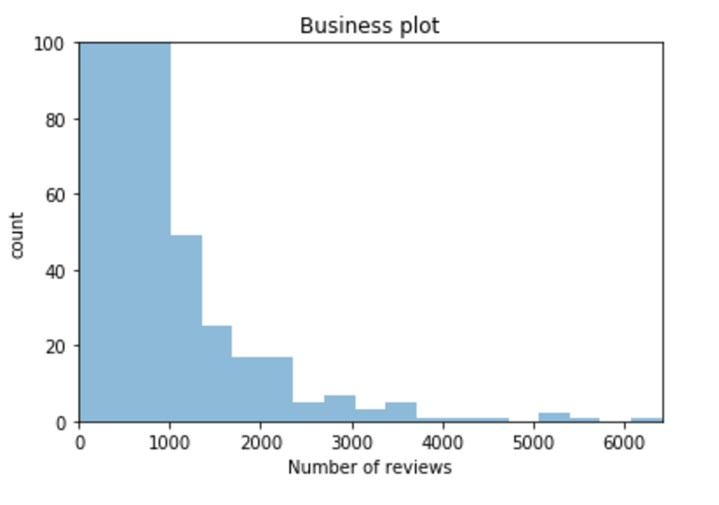
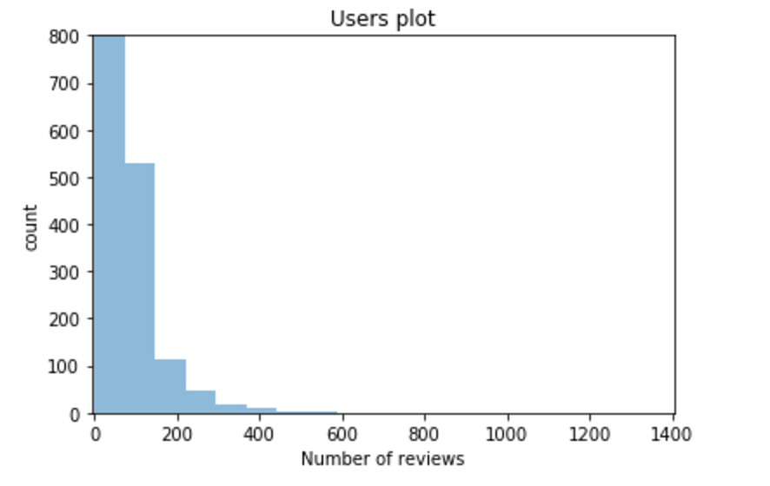
Highly Sparse Matrix
Few Active Users
Median number of reviews each restaurant received:
12
Median number of reviews each user generated:
1

Slide 5

Focus on TOP 1% active users
Users who reviewed 20+ restaurants
1000 Restaurants covered

Slide 6

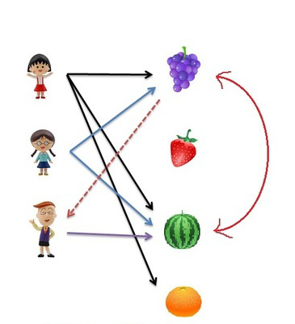
Item-Based Collaborative Filtering Calculate correlation between each pair of restaurants by observing all the users who have rated both restaurants

Slide 7
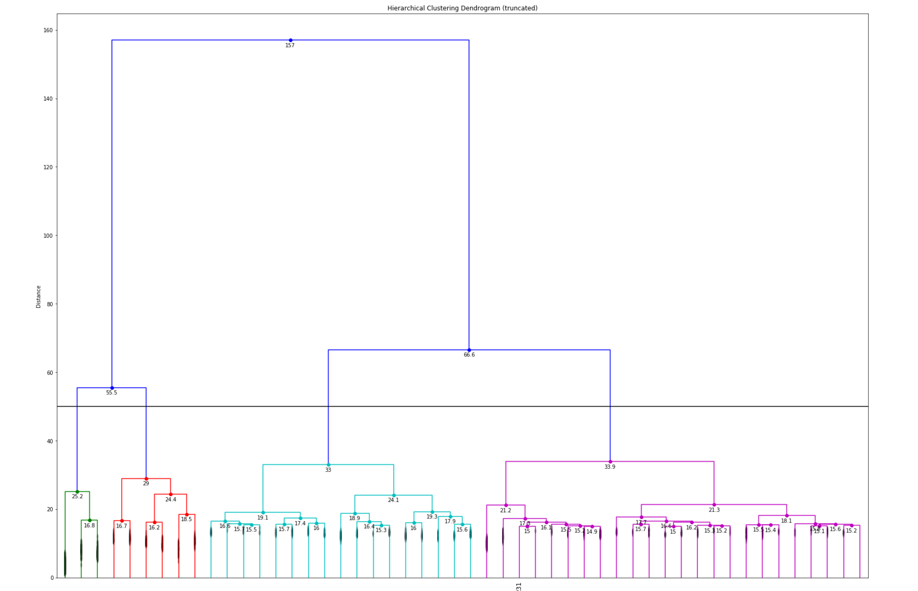
Clustering!

Slide 8
Content Based Recommendation
Review Text:
TF IDF
Category Data:
Euclidean
Distance
Attribute Data
Binary Information about Features.

Slide 9
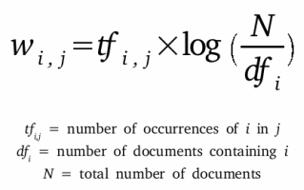
Text Data
Remove numbers, punctuation and stop-words using NLTK.
Stem and Lemmatize to recognize semantically identical words.
Having to Hav.
Am to be.
Extract top 1,000 words.
SKLearn to vectorize and analyze similarity.

Slide 10
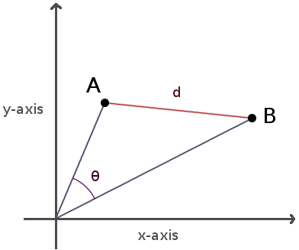
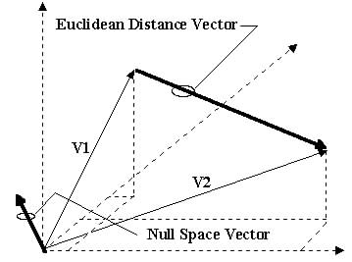
Category Data
Hundreds of categories.
Binarized and analyzed as pre-processed text data using cosine similarity
Attribute Data
List of attributes about each restaurant.
Common length and structure made Euclidean distance an effective measurement.

Slide 11
Results were… Good?ood?
At this point in time, we thought we were going to proceed to build machine learning models to decide which restaurants to recommend.
That approach was fundamentally wrong.
Pinpointing clusters of restaurants in a similar vector space does not meet our established objectives.
Provided uninteresting homogenous results.

Slide 12
Rethinking Our Goal
Techniques we used pinpointed close items in a vector space.
A list of similar restaurants is useless.
New goal:
Create a list that offers Novelty.
Helps user Explore vector space.
Identify unexplored areas of the vector space that may be interesting given user history.

Slide 13
Product
Novel hybrid recommendation system that incorporates collaborative filtering, expert user identification, and arbitrary multidimensional similarity to help users explore new types of restaurants at the periphery of their established interests.
Picks top recommendations based on multiple levels of similarity.
Offers clusters to dig deeper into individual categories.
Weights popular, highly rated, and highly rated by serial reviewers.

Slide 14
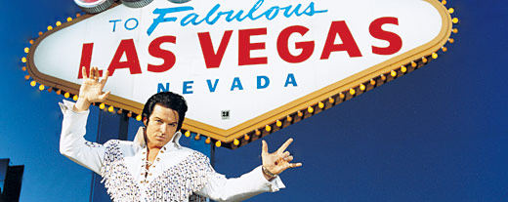
Demo

